Slide 1






Process &
Service Management

Slide 2

TABLE OF CONTENTS
01
Managing Services
04
Quiz
02
Monitoring Processes
05
Resources
03
Terminating Processes

Slide 3
Managing Services
(Linux)

Slide 4





systemctl
Service management can be done on the command line! This is thanks to the systemctl command. systemctl has different options to choose from when running the command. Some of the basic ones include stop, restart, status, and enable. When running these commands, you will also specify the service you are wanting to manage.

Slide 5
systemctl Options
stop
Stops the specified service
Command format: systemctl stop <ServiceName>
restart
Restarts the specified service
Command format: systemctl restart <ServiceName>
status
Displays useful information about the service
Command format: systemctl status <ServiceName>
enable
Configures service to start on boot
Command format: systemctl enable <ServiceName>
Example: To enable the ufw firewall: systemctl enable ufw

Slide 6
Monitoring Processes

Slide 7
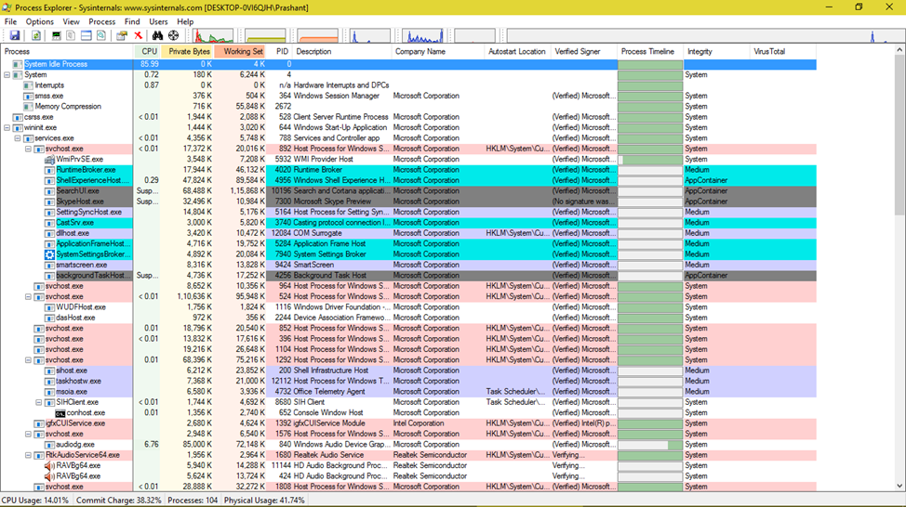
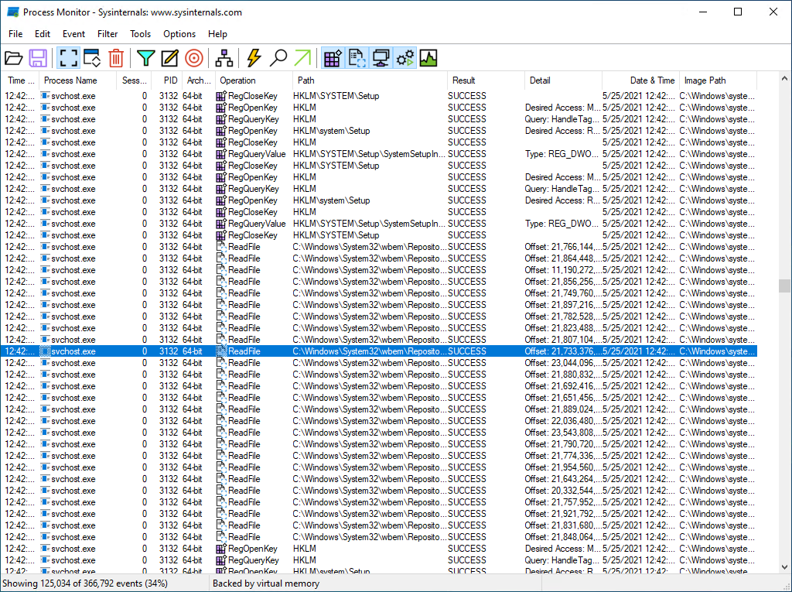
Running Processes (Windows)
To monitor running processes, you have many options in Windows. You can use the PowerShell and run the get-process command. This will list out all of your processes in the terminal. You can also use the Process Explorer and Process Monitor applications, which are both available in Windows Sysinternals. Lastly, you can use the Task Manager that you learned about in Module 2: Operating Systems!

Slide 8
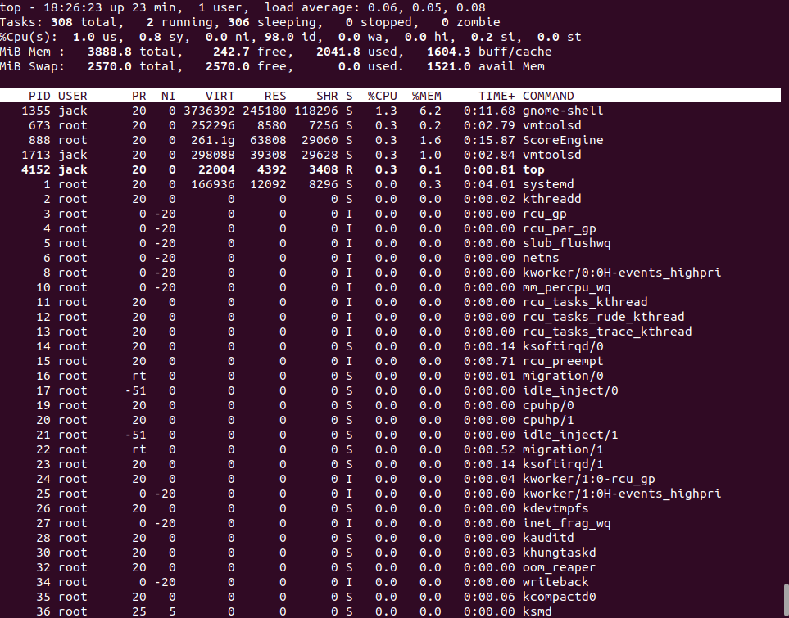
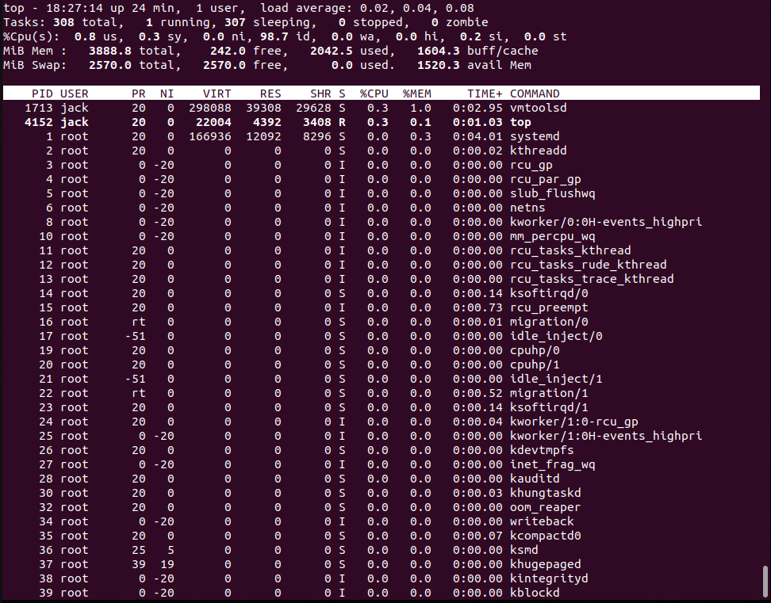
Running Processes (Linux)
There are two commands that you can use to monitor processes in a Linux machine. The first is top, which displays running processes, updating every few seconds. You can see in the images on the right that top results can change a lot within just a minute. You are able to view overall usage and details for individual processes.

Slide 9
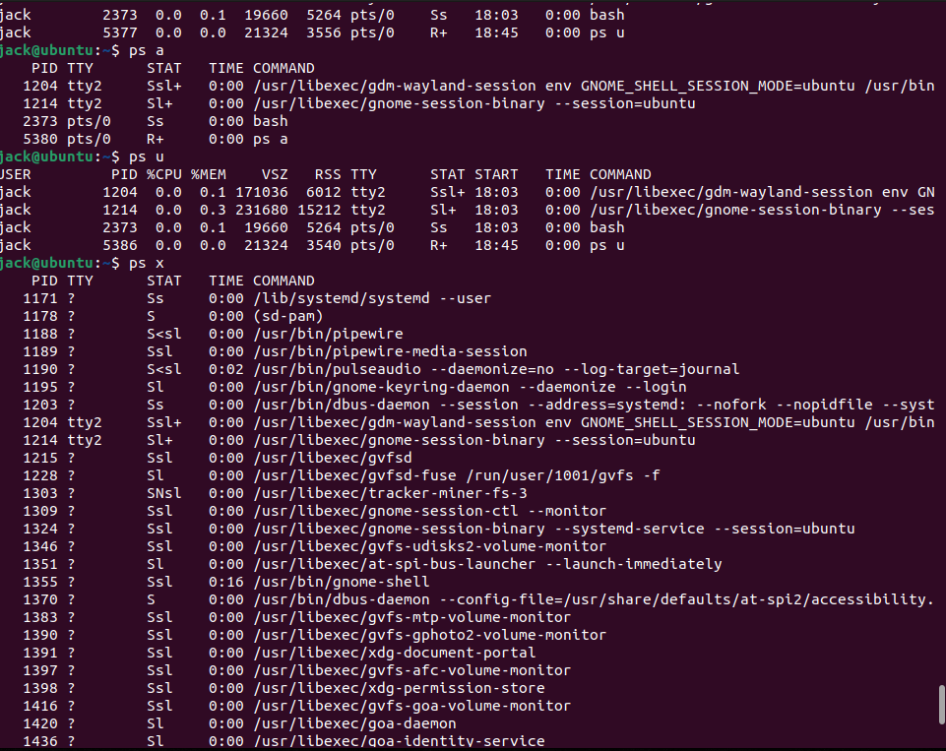
Running Processes (Linux)
The second command is ps, which also displays running processes. ps has several important options that you can use with the command:
a: lists processes started by all users
u: lists processes in a user-oriented format
x: lists processes that aren’t attached to a terminal
j: displays job control information (ex: process group ID)
f: shows processes in a tree format, showing parent-child relationships
Other ps options include:
aux: lists all processes in system, regardless of user and terminal
axjf: displays all running processes, showing parent-child relationships

Slide 10
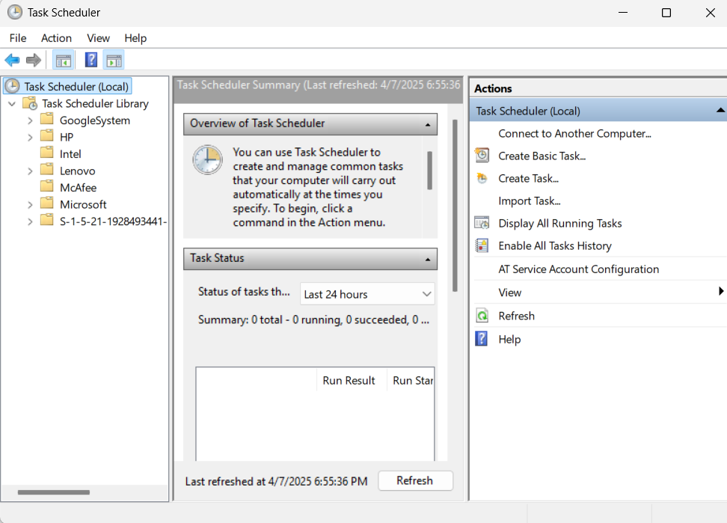
Scheduled Processes (Windows)
There are also many options for monitoring scheduled processes in Windows. You can use the Autorun and Process Monitor applications from Windows Sysinternal. You can also use the Task Scheduler application. Expand the Task Scheduler Library folder on the left side, and everything in that is a scheduled process! You can also use Registry Keys to view your scheduled processes

Slide 11
Terminating Processes

Slide 12
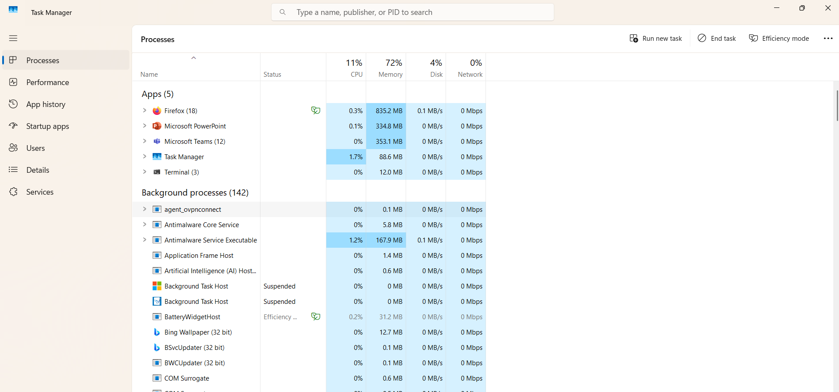
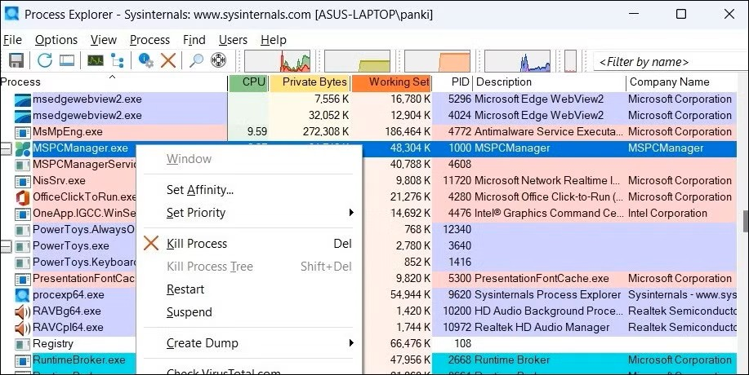
Running Processes (Windows)
Task Manager: click on a task and hit the End Task button in the top right
There are several ways to terminate processes on Windows. As mentioned in monitoring processes, the Task Manager and Process Explorer can also be used to terminate processes. There are also two commands that you can use in PowerShell and one command you can use in Command Prompt.
Process Explorer: right-click a process and select Kill Process

Slide 13
Running Processes (Windows)
The two PowerShell commands are:
stop-process: forces process to stop flag
Command format:
stop-process –Name <ProcessName> -Force
stop-service: stops Windows services
Command format:
stop-service –Name <ServiceName> -Force
The –Force flag will force the process/service to stop even if it has dependencies.
The command for the Command Prompt is taskkill. It has a few parameters that you could use with it:
/IM (Image Name): kills processes by name
/PID (Process ID): kills processes by ID
/F: forcefully terminates processes
Example: taskkill /IM notepad.exe /F

Slide 14
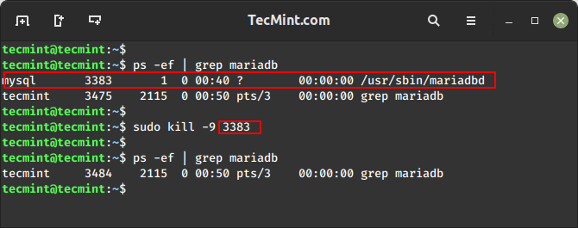
Running Processes (Linux)
To stop running processes in Linux, you can use the kill command.
Command format:
kill -9 <ProcessID>
You can find the process ID with the commands discussed in monitoring the processes. It will be the PID column.

Slide 15
Scheduled Processes (Windows)
To terminate scheduled processes, you can use the Task Scheduler application that was discussed earlier. There is also a command for both PowerShell and the Command Line that can be used.
Powershell: Unregister-ScheduledTask –TaskName <TaskName> -Confirm:$false
-Confirm:$false gets rid of any confirmation prompts
Command Line: schtasks /delete /tn <TaskName> /f
/delete deletes scheduled task flag
/tn is the task name flag
/f forces deletion flag

Slide 16

QUIZ!
Test your knowledge! Remember your answers so you can check them at the end!

Slide 17



Question 1
Which command is used to stop a service in Linux?
systemctl halt
systemctl end
systemctl stop

Slide 18
Question 2
What tool allows viewing and managing scheduled tasks from the command line in Windows?
schtasks
taskkill
ps

Slide 19
Question 3
Which command shows a live-updating view of running processes in Linux?
ps
top
systemctl

Slide 20
Question 4
In which of these Windows applications can you terminate a running process?
Task Monitor
Task Explorer
Task Manager

Slide 21
Question 5
What does the /F flag do to the taskkill command?
Forces termination
Finds the task
Filters tasks

Slide 22
Question 6
Which Linux command can be used to forcefully terminate a process by PID?
kill -9
exit
top

Slide 23


Quiz Answers
Question 1
The systemctl stop command is used to stop a service in Linux
Question 2
The schtasks tool allows viewing and managing scheduled tasks from the command line in Windows.
Question 3
The top command shows a live-updating view of running processes in Linux.

Slide 24
Quiz Answers
Question 4
The Task Manager terminates a running process in Windows.
Question 5
The /F flag for the taskkill command forces termination.
Question 6
The kill -9 command can be used to forcefully terminate a process by PID.

Slide 25

Resources
01
Sysinternals Process Explorer
02
Sysinternals Process Monitor
03
Sysinternals Autoruns

Slide 26



THANK
YOU!

